Slide 1

Issues Management in the 21st Century
Reena Mistry
Edelman Issues & Crisis

Slide 2

Corporations are Facing a New Era of Crisis
The speed of risk has become 280 characters or less.
The traditional concepts of containment are no longer possible.
Facts are negotiable. The risk of not controlling the narrative or leaving a void for others to fill is greater than ever.
There are no safe havens from digitally empowered agendas and social exposure.

Slide 3

The digital age
There is no such thing as a local crisis in the digital age today. Social media plays a significant role in spreading the story exponentially with just a few clicks. Yet companies tend to take too long to respond.
28% of crises spread internationally within 1 hour
On average it takes 21 hours before companies are able to issue meaningful external communications to defend themselves
69% of crises spread internationally within 24 hours and on average reach 11 countries
1 year later, 53% of companies have not seen share prices regain pre-crisis levels

Slide 4

Crisis Communications
Key insights and principles for managing risk and preserving reputation

Slide 5
Crisis Management: Two Perspectives
OPERATIONS
COMMUNICATIONS
“How do we fix this problem?”
“How do we safeguard our reputation while this problem is fixed?”
Organizations that fail to deliver information to stakeholders and media firsthand risk their stories being told through rumor, conjecture, misperceptions and misinformation

Slide 6
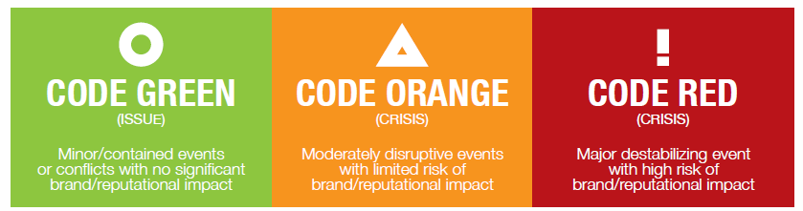
Is this a Crisis?
(RISK)
(ISSUE)
(CRISIS)
An identified weak-spot that should be looked into so that it doesn’t become an issue or escalate to crisis status.
A matter that if not dealt with, may negatively shift stakeholder perception and effect your ability to do business.
An incident that immediately stops your operations and effect your ability to do business.
Points to consider:
Level of impact to business functions
Level of impact to company’s values
Level of impact to key stakeholders
Level of impact to company’s financials
Anticipated outcome if ignored
Anticipated lifecycle (traditional, online, social)

Slide 7




Preparation mindset & orientation
xcxxc
EXECUTIVE LEADERSHIP
LEGAL COUNSEL
Reputation management is not a corporate function, but a capability.
PUBLIC AFFAIRS
OPERATIONS

Slide 8
Legal and Regulatory Landscape
- UK and international charities face increasingly complex legal and regulatory challenges
Key regulators and authorities include:
Charity Commission
Fundraising Regulator – voluntary, self-regulation
Information Commissioner
Key legislation that impacts charities includes:
Charities (Protection and Social Investment) Act 2016 giving power to
  Issue official warnings
  Disqualify trustees
  Winding up
EU General Data Protection Regulation (GDPR)
Code of Fundraising Practice

Slide 9
Recent legal issues faced by charities
- The Oxfam scandal is just the latest in a long line of scandals to dog the sector
Oxfam – 7,000 donors lost almost overnight following allegations of sexual abuse in Haiti
Kids Company – went into liquidation following allegations of misuse of company funds
RSPCA and British Heart Foundation – Wealth screening donors – fined by the Information Commissioner and adverse media coverage
National Childbirth Trust – Inquest proceedings and charitable governance issues
- All represented the interface between complex legal issues and communications.

Slide 10
Legally Informed Communications
- Professionalising Communications Services
Business critical issues are increasingly defined by a combined legal
and communications response.
Charities are as much concerned by damage to their reputation and impact on donations as they are to legal consequences of litigation or regulatory intervention
A flawed communications response can be fatal to a charity.
Professional service advisors must collaborate to ensure charities are properly advised and supported.
Communications advisors must have a proper understanding of the legal issues
that underpin any crisis or reputation threat.

Slide 11

1st Principle
STAKEHOLDERS
HATE SURPRISES

Slide 12

2nd Principle
ACTIVISTS ARE DOING
THEIR HOMEWORK

Slide 13

3rd Principle
YOU’RE
JUDGED
BY THE
COMPANY
YOU KEEP

Slide 14

4th Principle
PENETRATION OF
SOCIAL MEDIA MEANS ENTERPRISE MUST OWN
THE FACTUAL RECORD

Slide 15

5th Principle
TRANSPARENCY AND RISK ARE INVERSELY RELATED

Slide 16

6th Principle
ALIGN STAKEHOLDER INTERESTS WITH
STRATEGIC OBJECTIVES

Slide 17

7th Principle
NO SCENARIO IS
TOO FAR-FETCHED
If someone says “THAT’S IMPOSSIBLE”
understand it to mean: “According to
MY VERY NARROW AND LIMITED
UNDERSTANDING OF REALITY
that’s very unlikely.

Slide 18
The ten golden rules
Create a process for testing your company’s crisis readiness
When crises emerge,
DEFINE the story or
it WILL DEFINE YOU
Establish the facts: determine what you know, what you don’t know and a fact-finding process
Be the most credible public source of facts
Lead with the positive – what do you support?
Support key messages with proof points, anecdotes, statistics, stories and third-parties*
Understand and embrace cultural differences and expectations
Take the time to provide background and context
Recognise that crises are always emotionally charged and information is never perfect - plan for this
Ensure regulators hear the news from you – NOT the media
*Do NOT answer questions that are leading, hypothetical or based on incorrect information.

